Slide 1

DATA SCIENCE PROJECT
PREDICT STUDENTS’ DROPOUT AND ACADEMIC SUCCESS
Team PathToScholar G-00015
Hoang Minh Bui
Caden L Carrier-Rieger

Slide 2
CONTENTS
Introduction
a. Objectives
b. About the dataset
2. Methods
a. Data processing
b. SVM
c. MLP Classifier
d. Multiple-layered Tensorflow Keras Neural Network
3. Results
4. Conclusion

Slide 3
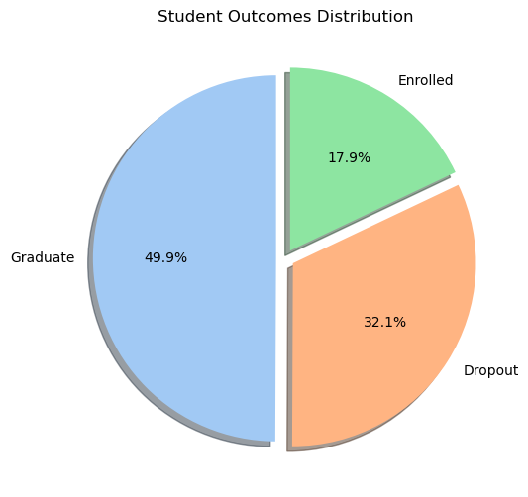
1. Introduction a. Objectives
The target variable represents a student’s final academic status at the end of the normal duration of their degree program.

Slide 4
1. Introduction a. Objectives
We want to contribute to the reduction of academic dropout and failure in higher education
Analyze this dataset
Build models to predict
Find top 10 important features affecting academic performance

Slide 5
1. Introduction b. About the Dataset
The dataset is related to students enrolled in different undergraduate degrees
4424 instances
36 features

Slide 6
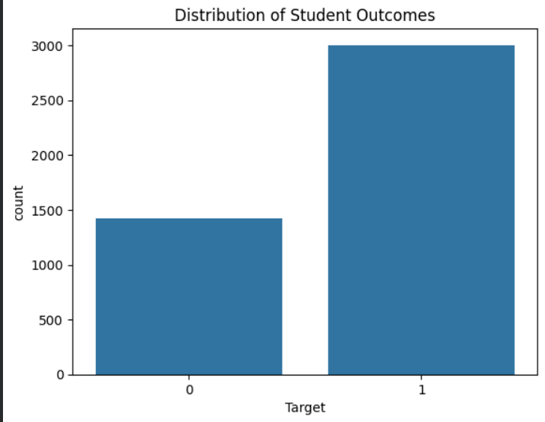
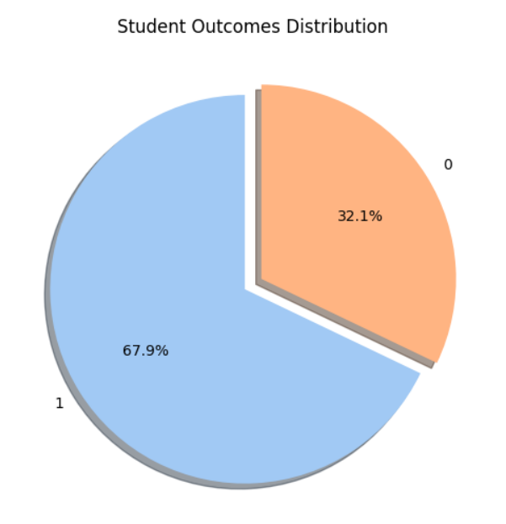
2. Methods a. Data Processing
Our data preprocessing involved:
- Train and test split with a 20% split
- Standard scaling the X train and test variables
- Combined the graduate and enrolled target variables
- Set target variables to integers: Graduate is 1 and Dropout is 0
Example of what the changes look like after preprocessing

Slide 7
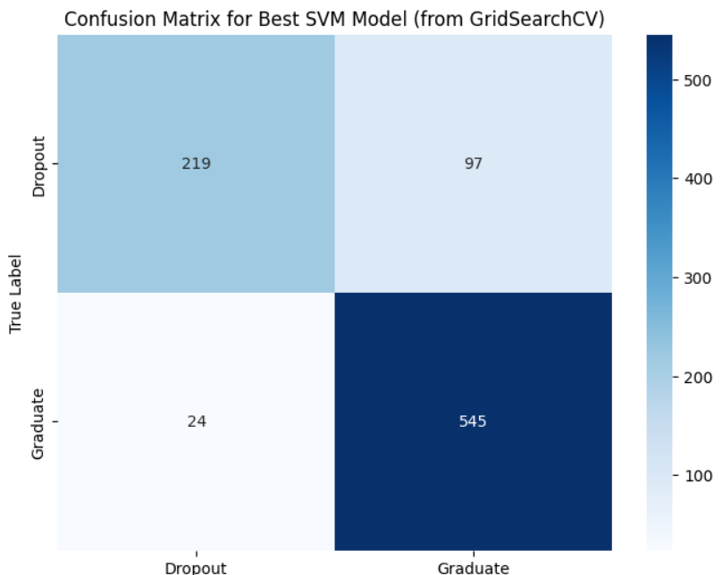
2. Methods b. SVM
Build a model using sklearn SVM
Use GridSearchCV to improve the accuracy
- Test Accuracy: 86%

Slide 8
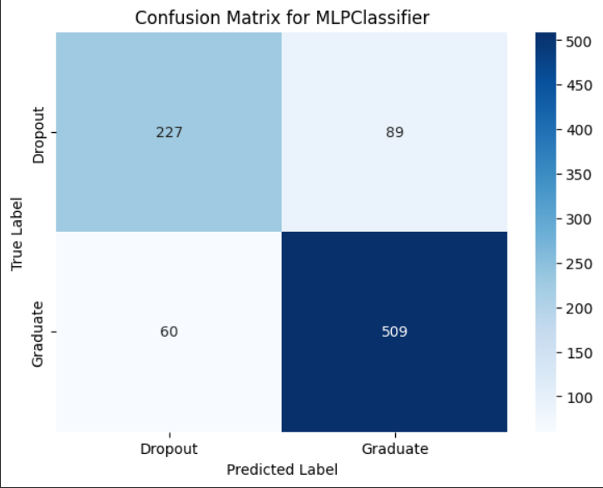
2. Methods c. MLPClassifier
Implement a Neural Network model using sklearn's MLPClassifier
Apply GridSearch for hyperparameter tuning
- Test Accuracy: 0.83

Slide 9
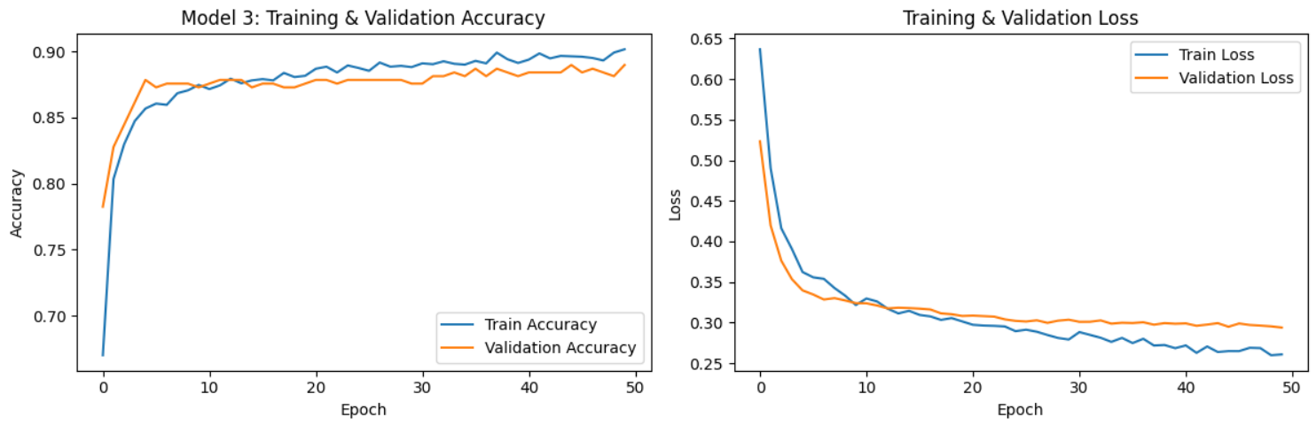
2. Methods d. Multiple-layered Tensorflow Keras Neural Network
Created a deep learning model with a validation split of 10%
Uses four dense layers (includes output), relu for the hidden, sigmoid for output
Uses two dropout layers placed after the first two layers
- Test Accuracy: 88%, With a clear decrease in validation loss

Slide 10
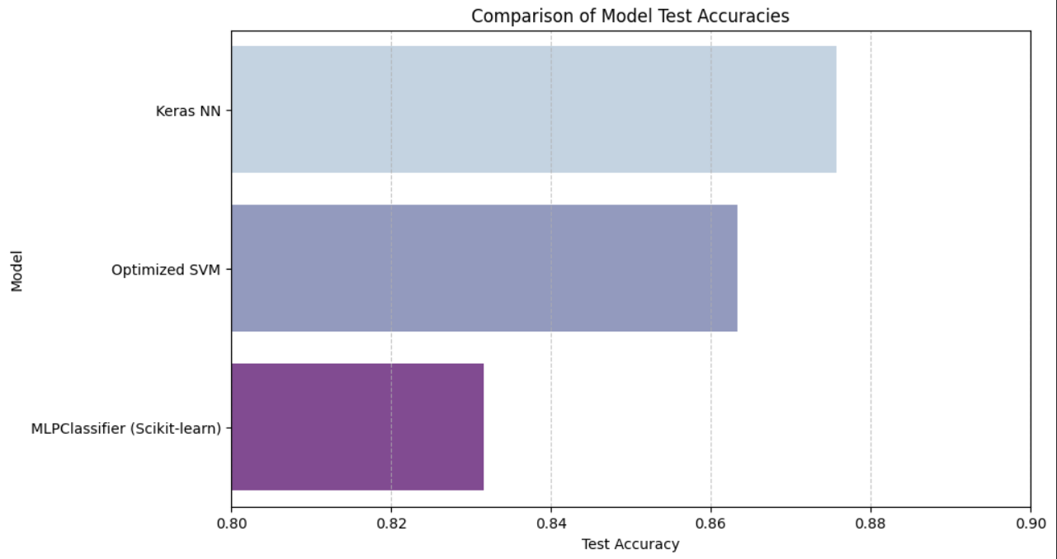
3. Results a. Comparison
Clearly, the Keras multi-layered neural network gives the best accuracy

Slide 11
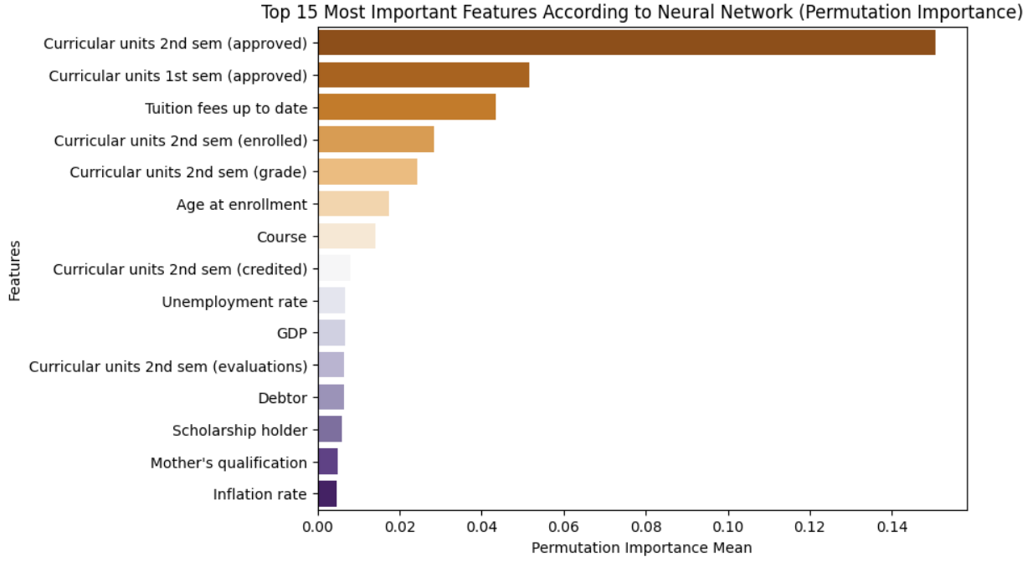
3. Results b. Most Important Features

Slide 12
4. Conclusion
-There is now a model that can predict whether a student will become a dropout or academically succeed with 88% accuracy
-By using permutation importance, the model has found the most important elements when it comes to academic success
-In no way is the importance of the features the end-all and be-all; there are many unique circumstances. The purpose of this project is to identify areas where students are likely to drop out, so that those students can attempt to steer themselves back onto the path of academic success.

Slide 13
Future Direction
-Get a larger dataset to draw from, over 4000 is good, but more can hopefully give a better variety and overall accuracy for general higher education
-Add more features to the dataset, more topical ones like AI use
-Explore even more options with models, whether in depth or a different type of model altogether

Slide 14
Acknowledgements
This is the citation for the dataset used:
M.V.Martins, D. Tolledo, J. Machado, L. M.T. Baptista, V.Realinho. (2021) "Early prediction of student’s performance in higher education: a case study" Trends and Applications in Information Systems and Technologies, vol.1, in Advances in Intelligent Systems and Computing series. Springer. DOI: 10.1007/978-3-030-72657-7_16

